Slide 1



FINAL_DASHBOARD_DWH
View in Power BI
Last data refresh:
5/27/2024 11:35:02 AM UTC
Downloaded at:
5/27/2024 5:00:42 PM UTC

Slide 2
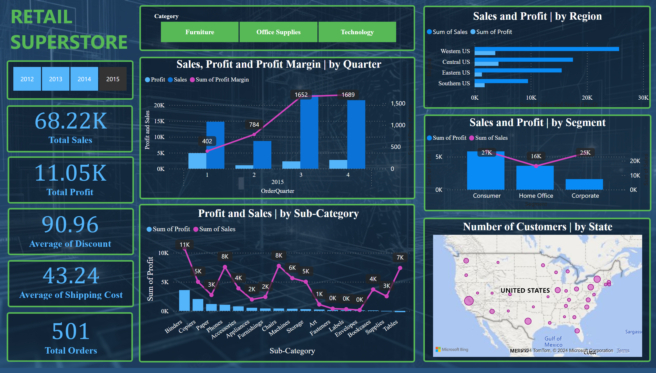
Overview
Notes:
shape
No alt text provided
Sales, Profit and Profit Margin | by Quarter
No alt text provided
shape
No alt text provided
Sales and Profit | by Segment
No alt text provided
shape
No alt text provided
Sales and Profit | by Region
No alt text provided
shape
No alt text provided
Profit and Sales | by Sub-Category
No alt text provided
shape
No alt text provided
Number of Customers | by State
No alt text provided
shape
No alt text provided
card
No alt text provided
shape
No alt text provided
slicer
No alt text provided
shape
No alt text provided
slicer
No alt text provided
textbox
No alt text provided
shape
No alt text provided
card
No alt text provided
shape
No alt text provided
card
No alt text provided
shape
No alt text provided
card
No alt text provided
shape
No alt text provided
card
No alt text provided

Slide 3
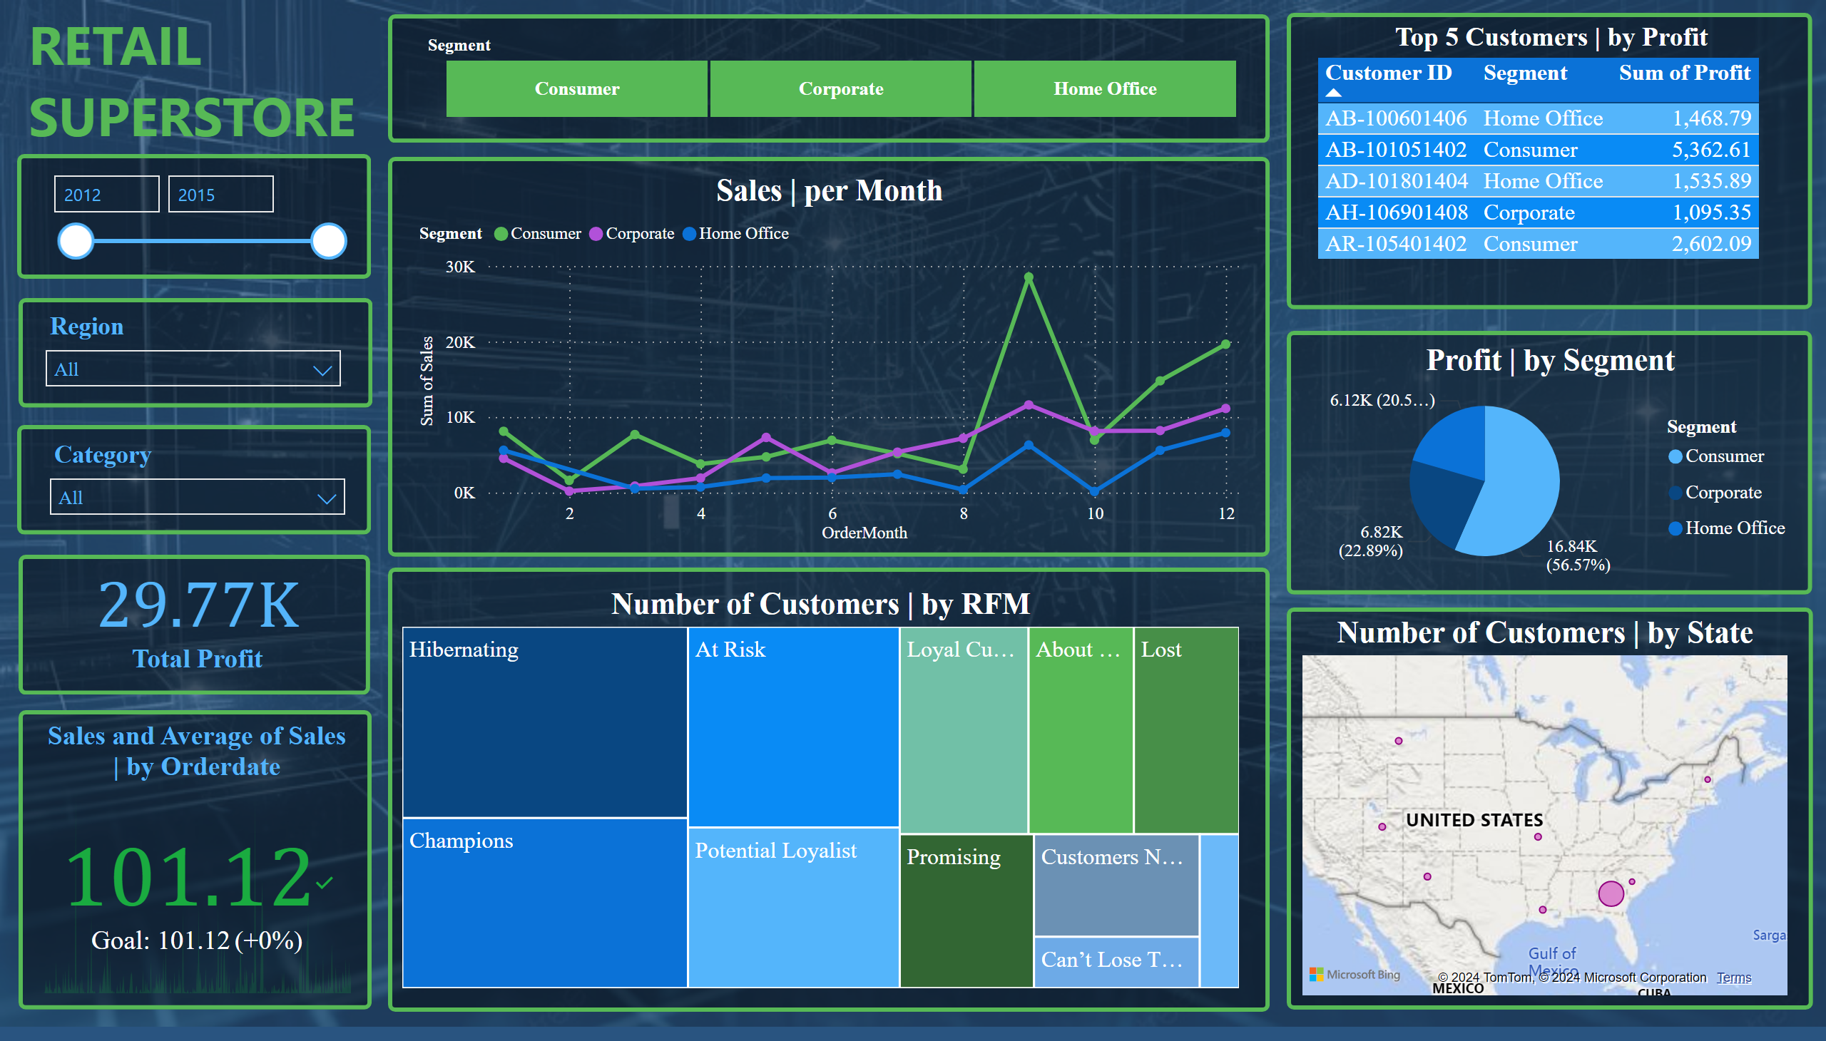
Customer
Notes:
shape
No alt text provided
Sales | per Month
No alt text provided
shape
No alt text provided
Profit | by Segment
No alt text provided
shape
No alt text provided
Top 5 Customers | by Profit
No alt text provided
shape
No alt text provided
Number of Customers | by RFM
No alt text provided
shape
No alt text provided
shape
No alt text provided
shape
No alt text provided
shape
No alt text provided
slicer
No alt text provided
slicer
No alt text provided
shape
No alt text provided
shape
No alt text provided
slicer
No alt text provided
shape
No alt text provided
slicer
No alt text provided
textbox
No alt text provided
Sales and Average of Sales | by Orderdate
No alt text provided
card
No alt text provided
Number of Customers | by State
No alt text provided

Slide 4
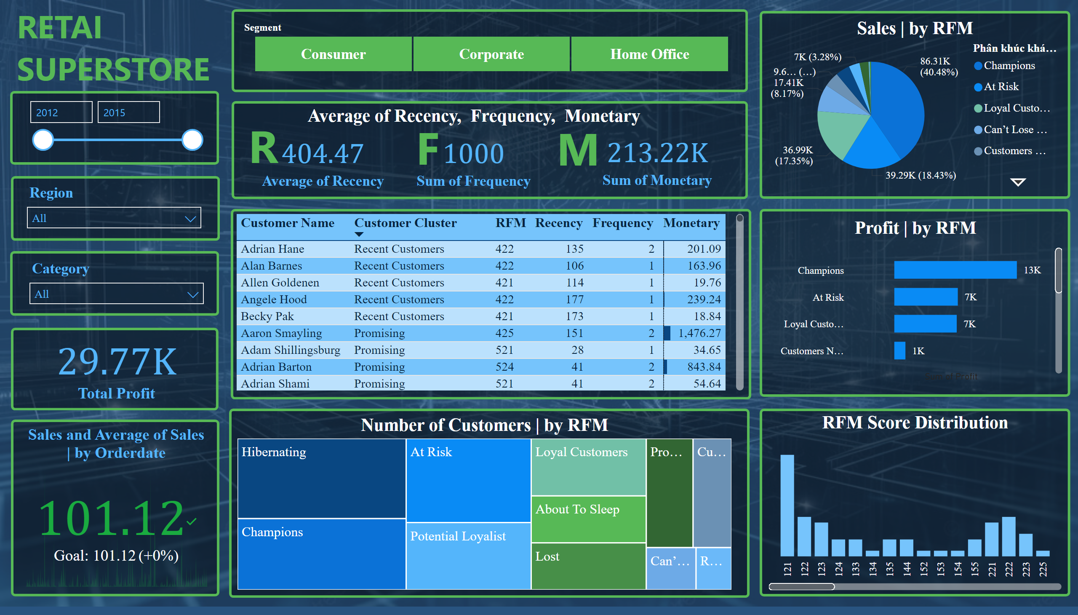
RFM
Notes:
shape
No alt text provided
Sales | per Month
No alt text provided
shape
No alt text provided
Profit | by RFM
No alt text provided
shape
No alt text provided
shape
No alt text provided
Number of Customers | by RFM
No alt text provided
shape
No alt text provided
RFM Score Distribution
No alt text provided
shape
No alt text provided
slicer
No alt text provided
textbox
No alt text provided
card
No alt text provided
card
No alt text provided
card
No alt text provided
R
No alt text provided
R
No alt text provided
R
No alt text provided
textbox
No alt text provided
shape
No alt text provided
Sales | by RFM
No alt text provided
slicer
No alt text provided
shape
No alt text provided
card
No alt text provided
Sales and Average of Sales | by Orderdate
No alt text provided
shape
No alt text provided
slicer
No alt text provided
slicer
No alt text provided
shape
No alt text provided
shape
No alt text provided
shape
No alt text provided

Slide 5
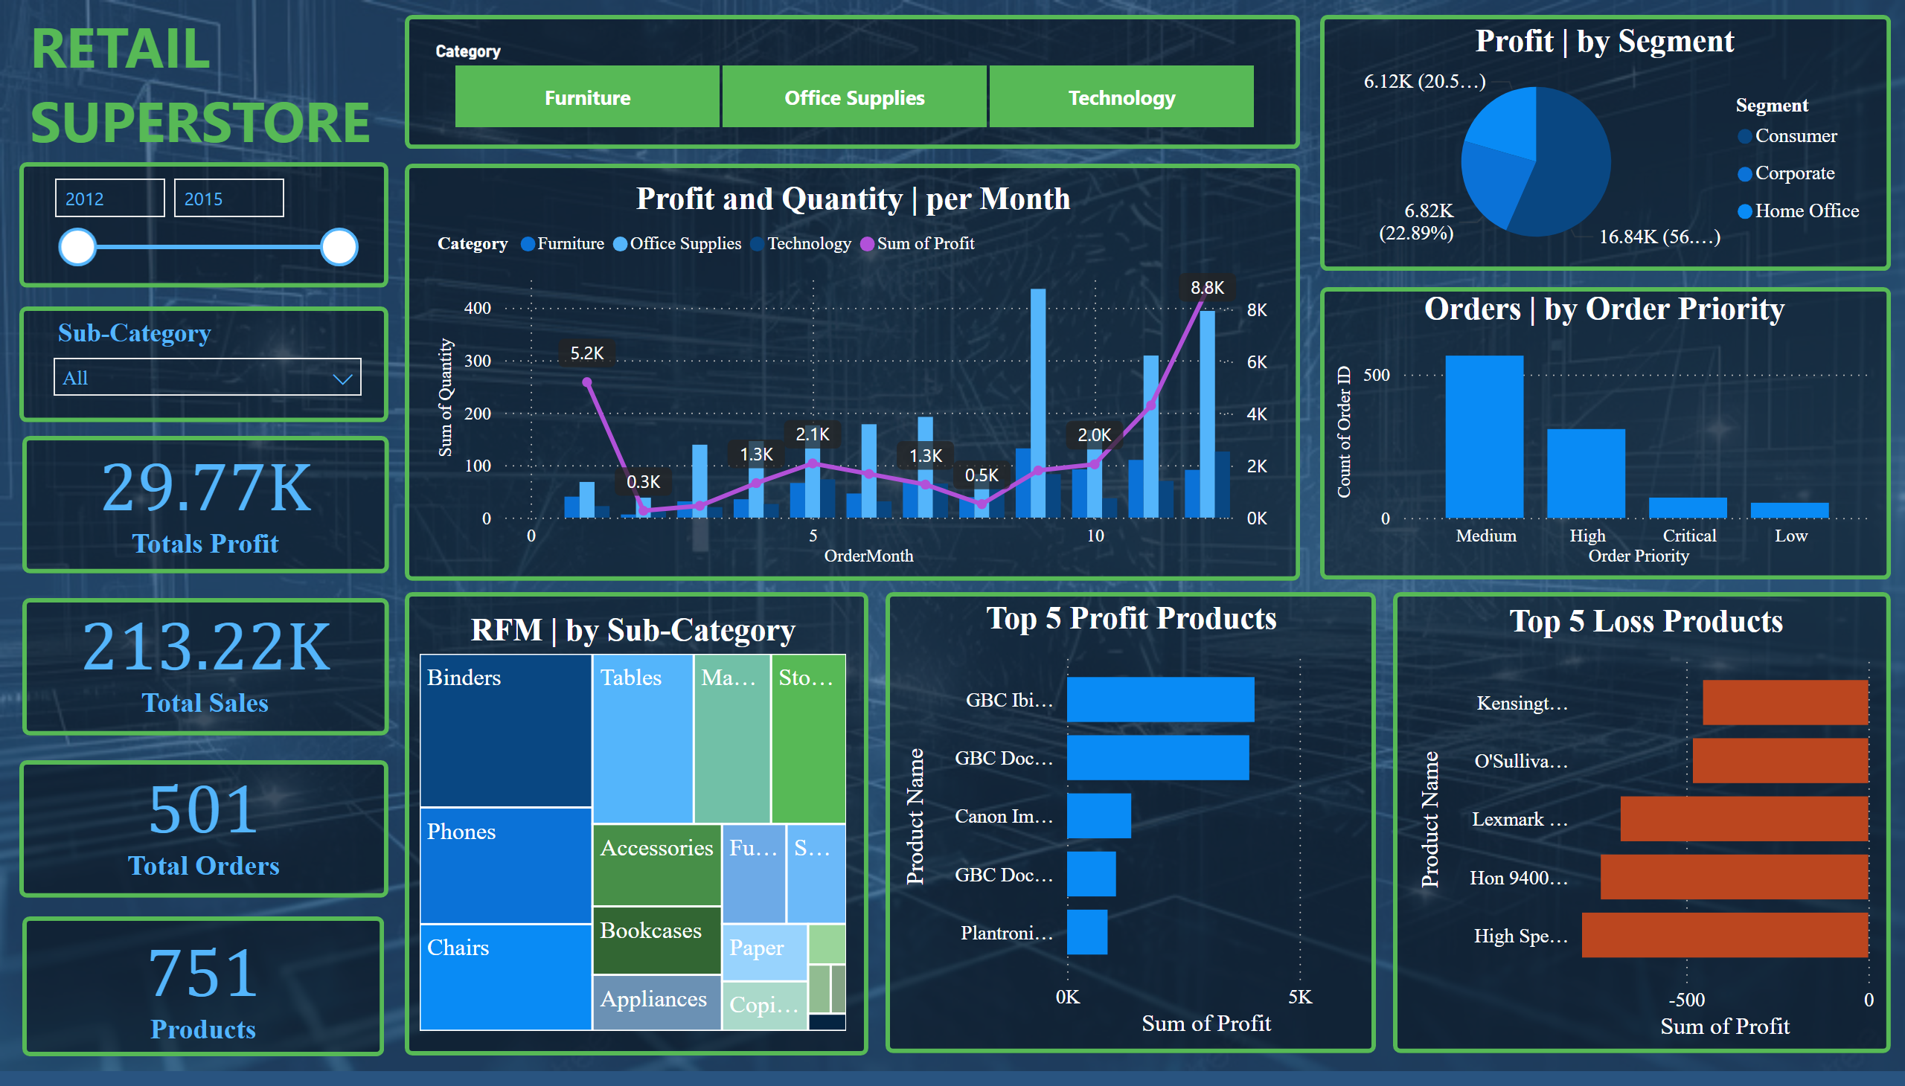
Product
Notes:
shape
No alt text provided
Profit and Quantity | per Month
No alt text provided
shape
No alt text provided
shape
No alt text provided
shape
No alt text provided
RFM | by Sub-Category
No alt text provided
shape
No alt text provided
Orders | by Order Priority
No alt text provided
shape
No alt text provided
slicer
No alt text provided
shape
No alt text provided
slicer
No alt text provided
textbox
No alt text provided
shape
No alt text provided
Top 5 Loss Products
No alt text provided
Profit | by Segment
No alt text provided
Top 5 Profit Products
No alt text provided
card
No alt text provided
shape
No alt text provided
card
No alt text provided
shape
No alt text provided
card
No alt text provided
shape
No alt text provided
slicer
No alt text provided
shape
No alt text provided
card
No alt text provided
shape
No alt text provided

Slide 6
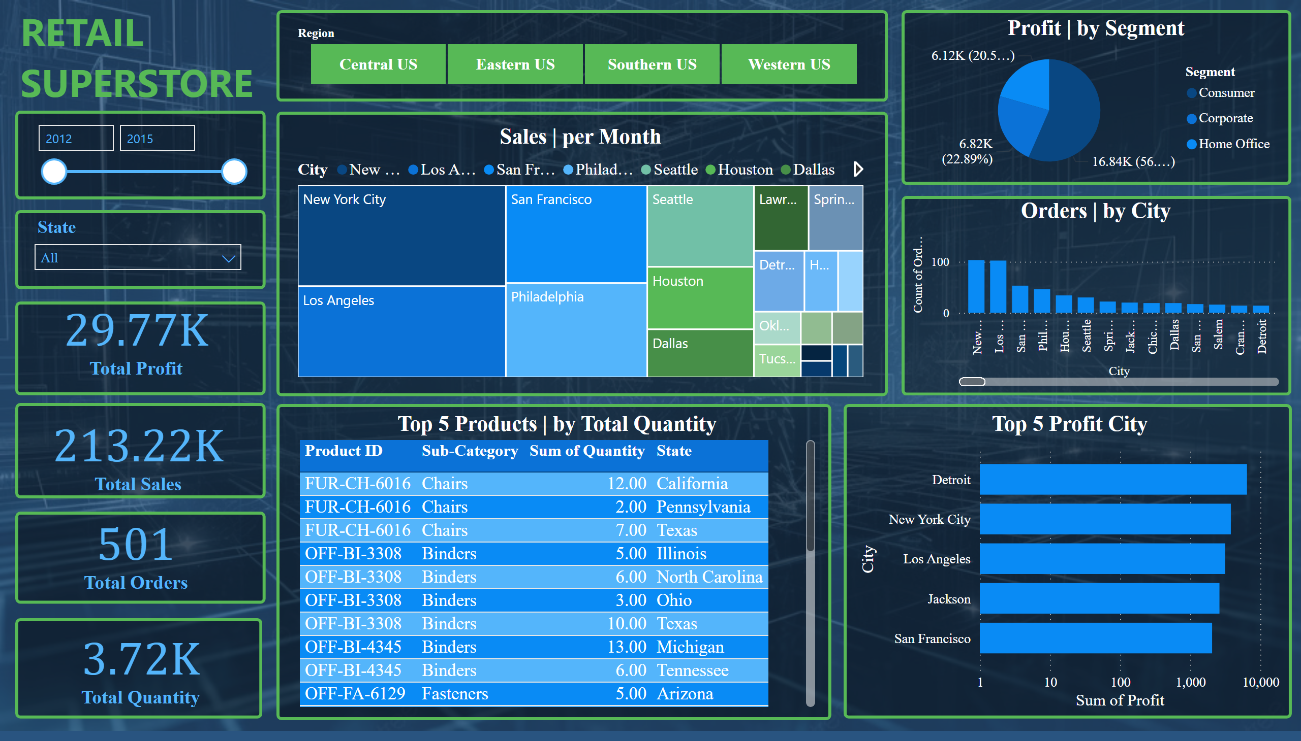
Region
Notes:
shape
No alt text provided
Sales | per Month
No alt text provided
shape
No alt text provided
shape
No alt text provided
shape
No alt text provided
Orders | by City
No alt text provided
shape
No alt text provided
shape
No alt text provided
slicer
No alt text provided
shape
No alt text provided
slicer
No alt text provided
textbox
No alt text provided
shape
No alt text provided
Profit | by Segment
No alt text provided
Top 5 Profit City
No alt text provided
Top 5 Products | by Total Quantity
No alt text provided
slicer
No alt text provided
card
No alt text provided
shape
No alt text provided
card
No alt text provided
shape
No alt text provided
card
No alt text provided
shape
No alt text provided
card
No alt text provided
shape
No alt text provided

